Slide 1
AI Assignment: Protein Amino Acid Visualizer
Tanaka, Soso, Olivia, Wasay, and Joy
https://github.com/tanakam79243/capstone_in_neuroscience.git

Slide 2
Background: The Problem
Key Players : Huntingtin, A-syn, Lewy bodies
CAG repeat expansion -> Poly Q
A-syn -> misfolding -> aggregates -> Lewy bodies
Damages are functional and not always visible
Alters membrane dynamics
Scale, Interaction/dynamics and compilations
Notes:
So for our AI project we focused on visualzing pathogenic proteins when being able to alter its amino acid sequences. For example
as we all know from our previous JC and classes, huntingtons disease it attributed to the mutation of the huntingtin protein where an expanded CAG repeat leads to abnormally long polyq tracts causing the protein to misfold and aggregate but its not like they just sit there idealy they end up causing major disruptions in axonal transport, gene transcriptions etc. all important things for neuronal survival and similarly with a-syn misfolding causes disrutpion in things such as vessicle trafficking. So for pathogenic proteins such as huntingtin and A-syn our problem was in the fact that not only are they incredible small and hard to detect but their interactions with other molecules fluctuates, because with changing a single amino acid can literally change its ability to bind to other membranes, vessicles or even other proteins. And it can get particularly difficult to say okay this is the interaction im looking for because it’s a transient and constantly changing interaction. What we tried to address here is how can we make it easier to identify these structures that change morphology when damaged and how can being able to change/play around with the amino acids help with being able to essentially tag this protein with more detectable markers or even stabalize it or identify functioning regions . But my gorups members will get into how we went about that solution.

Slide 3
Background: the Solution
Protein Amino Acid Visualizer— creates a representation of the protein
Visual, structural features
Residue interactions
Interactions with cellular components
Bottom line: ability to easily/quickly understand how sequence changes translate to the cellular level

Slide 4
Program Showcase

Slide 5
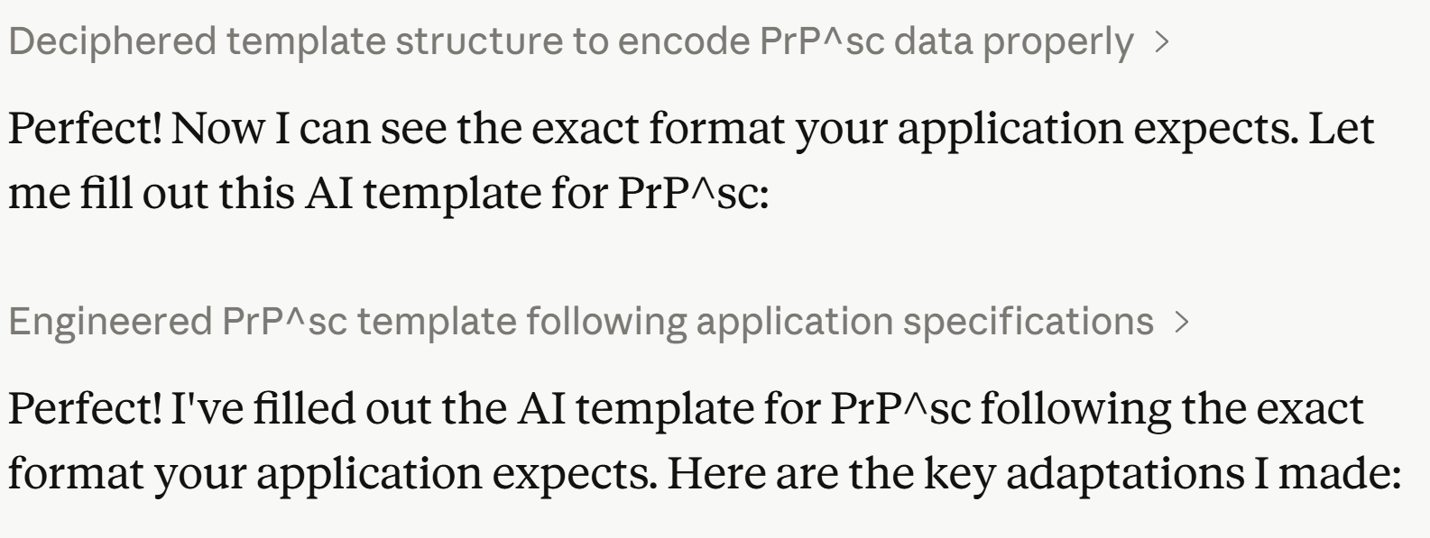
Sample Protein Fabrication
JSON template created that AI proceeds to "fill out."
Answers key questions for protein viewing in program
Sample demonstration: PrP^{SC}

Slide 6


Coding the Assignment
Tools Used:
Codex
Used "precise" prompting
Understanding file types
.json, .html, .css, .md
Github
Storing the files

